Slide 1
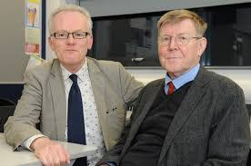
We’re Not Afraid to Die…. If We Can All Be Together
By Gordon Cook & Alan East

Slide 2
About the Author
Gordon Cook (born December 3, 1978, in Toronto is a two-time Canadian Olympic sailor. He sails for the Royal Canadian Yacht Club. He is the son of Stephen Cook and Linda Cook. He is a graduate of the Engineering Physics program at Queen's University. At Queen's University, he also met his 2008 Olympic team partner Ben Remocker, where they were members of the university sailing team. Cook and Remocker became the first Canadians to sail a 49er in an Olympic Regatta at the 2008 Beijing Olympics, where they finished 14th. He sails for the Royal Canadian Yacht Club and had a great interest in writing stories.
Alan East was a litigator, manager and legal trainer. He is a co-founder of a multi-academy trust Central Academies Trust which has as its aim improving standards in Secondary Education.

Slide 3
Vocabulary
Honing – sharpen, improving
Seafaring – regularly traveling by sea
Wooden-hulled – a watertight body of a ship
Gales – A very strong wind
Mast – a tall pole in a ship that supports the sails
Gigantic – huge; of a big size
Jib – a triangular staysail set forward the mast in a ship
Knots - a unit of speed equal to one nautical mile per hour, used especially of ships, aircraft, or winds
Lashed – to hit and tied with a lot of force
Mooring rope – rope with which a boat is fastened with a fixed object
Life rapt – life boat
Loop – a shape produced that bends round and crosses; bent
Stern – the back part of a ship or a boat
Donned – put on, wore
Oilskins – heavy cotton cloth waterproofed with oil

Slide 4
Impending – about to happen
Ominous silence – unpleasant or threatening silence
Aft – near the stern of the ship
Crest –top of a wave
Deck – a floor of a ship
Torrent – a fast moving stream of water
Capsizing – be overturned in the water
Hurled – throw with a great force
Taut – stretched or pulled tightly
Boom – pole that controls the angle and shape of the sail
Scrambled – climb; claw one’s way
Hatch – door on the deck of a ship
Starboard – right side of the boat
Bulged – swell
Sloshed – move through liquid with a splashing sound
Bashed – strike hard; hit
Dinghies – small open boats

Slide 5
Anchor – A heavy metal object dropped over the side of a ship to keep it in one place
Bunk – a sleeping berth in a ship
May-day calls – signals for getting help
Keel – a long piece of wood / metal along the bottom of the ship which helps it to keep uprightt
Rigging – ropes that balance the mast of the ship
Sextant – an instrument for measuring angles and distance

Slide 6
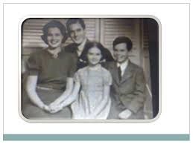
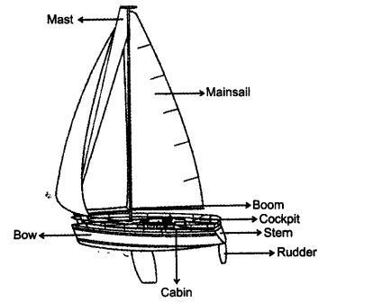
Introduction
This is a story of extreme courage and skill exhibited by Gordon Cook, his family and crewmen in a war with water and waves for survival. In July 1976, the narrator, his wife Mary, son Jonathan and daughter Suzanne set sail from Plymouth, England to duplicate the round-the world voyage made 200 years earlier by Captain James Cook.

Slide 7
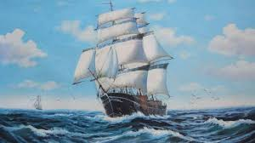
A dream to duplicate the round-the-world voyage
The narrator, a 37 year old businessman and his wife Mary have dreamt to voyage around the world like the famous Captain James Cook. For the voyage, they have been perfecting their seafaring skills for the past 16 years. They have got a professionally built, 23 metre and 30 ton wooden-hulled boat, Wavewalker. The boat has been tested for months in the roughest weathers.

Slide 8
The beginning of the voyage
In July 1976, the narrator, together with his wife and kids (son Jonathan, 6 and daughter Suzanne, 7) sets sail from Plymouth, England. The initial period of the three-year journey (from the west coast of Africa to Cape Town) proves to be quite pleasant. Before heading east, they employ two crewmen, namely, Larry Vigil and Herb Seigler to help them tackle one of the world’s roughest seas, the southern Indian Ocean.
The second day they encounter strong winds and alarming waves. By December 25, they manage to reach 3,500 kilometres east of Cape Town. Despite the bad weather, the family celebrates Christmas on the boat. However, the weather worsens with the passing time.

Slide 9
A catastrophe - the attack of the huge wave
On the early morning of January 2, the family faces strong, mighty waves and screaming winds. They attempt to slow down the boat by dropping the storm jib. They carry out life-raft drill and prepare themselves for the worst case scenario by donning life jackets and oilskins.
Later in the evening, a “perfectly vertical”, huge, tremendous wave hits the deck of the boat throwing the narrator off the boat. He accepts his ‘approaching death’ and begins to lose consciousness. The boat is just about to overturn when another huge wave comes and turns it right back. The narrator grabs the guard rails and sails into the boat’s main boom. He suffers injuries in his ribs and mouth.

Slide 10
Fight for survival
Realizing that the ship had water in its lower parts, he instructs Mary to take the wheel, while Larry and Herb pump out the water. He checks on the children in their cabin, where Sue informs him about a bump on her head to which he does not pay much attention.
The narrator begins waterproofing the gaping holes. Most of the water now deviated to the side. However, their hand-pumps block due to debris and the electric-pump gets short-circuited. Fortunately, he finds a spare electric pump and connects it to an out-pipe in order to drain out the water.
They keep pumping and steering all night long. Even their Mayday calls are not answered as they are in a remote corner of the world.

Slide 11
Injuries of Suzanne & Desperation to reach the land
Sue’s head swells, her eyes go black and has a deep cut on her arm. On being asked about her injuries, she replies to her father that she did not want to bother him when he was trying to save them.
The family manages to survive for 15 hours since the wave hit the boat. The water levels are controlled to a considerable level but they still have leaks below the waterline. They decide to rest and work in rotations.
The wave had left Wavewalker in a considerably bad state. Since it is not in a condition to make them reach Australia, they decide and hope to reach the nearest island, Ile Amsterdam, a French scientific base. Unfortunately, the chances to reach the island are very slim unless the wind and seas subside. Besides, their supporting engine had also been damaged.

Slide 12
January 4 and 5
After pumping out the water for 36 hours continuously, they take a sigh of relief as just a few centimetres of water is left to be pumped out. They decide to hoist the storm jib as the main mast is destroyed and head towards the supposed location of the islands.
Having found some corned beef and crackers, they eat their first meal in two days.
However, their relief is short-lived. The weather starts changing for the worse and by the morning of January 5, they are again left desperate.

Slide 13
Courageous Jonathan & Ongoing struggle of the Narrator
As the narrator goes to comfort the children, he is left spellbound to see the fearlessness of his son, Jonathan, who says that he does not fear death as long as they all are together. This fills the narrator with determination and courage to fight the sea.
He tries his best to protect the weakened starboard side. That evening, the narrator and his wife sit together holding hands, feeling hopeless and thinking that their end is approaching. But still with all the moral support that he receives from his children, he continues his efforts. Fortunately, Wavewalker sails through the storm. He works on the wind speeds in order to calculate their exact position. While he is thinking, Sue gives him a greeting card expressing her love, gratitude and optimism.
Though he is not very convinced, he instructs Larry to steer a course of 185 degrees saying that if they are lucky they can hope to find the island by the evening. He then goes to sleep with a heavy heart.

Slide 14
Ultimate victory
Fortunately, they sail on and manage to find Ile Amsterdam by evening. On being informed about this, the narrator's joy knows no bound. Jonathan calls him the “best captain” and the “best daddy” in the whole world. Soon, they get off-shore and reach the island with the help of its inhabitants.
Stepping on the land after such turmoil, the narrator’s thoughts are filled with cheerful and optimistic Larry and Herb; supportive Mary; a brave seven-year-old girl who did not want her parents to worry about her head injuries and a six-year-old boy who is not afraid to die.
At last we can say that the collective power of unity and the never-failing confidence of the sailors made it possible for them to survive and come out from the jaws of death.

Slide 15
Thank You

